Slide 1
Aerobic and Anaerobic Respiration
Year 11 Human Biology
ATAR
PowerPoint 8

Slide 2
SCSA Syllabus Reference
Cellular respiration occurs, in different locations in the cytosol and mitochondria, to catabolise organic compounds, aerobically or anaerobically, to release energy in the form of adenosine triphosphate (ATP)

Slide 3
Lesson Intention
To explore the process of cellular respiration

Slide 4
Success Criteria
define cellular respiration
state the chemical and word equation for cellular respiration
distinguish between ATP and ADP
describe the process of glycolysis
describe the process of anaerobic respiration
to explain the steps in aerobic respiration.
to state the chemical and word equation for aerobic respiration
to summarise how energy is used by the cell.

Slide 5
Vocabulary
Cellular Respiration: the chemical reactions that make energy available for the cell
Glycolysis: the breakdown of a glucose molecule to pyruvate; it releases energy to form two molecules of adenosine triphosphate (ATP)
Anaerobic Respiration: respiration that does not require oxygen
Oxygen debt: extra oxygen required, in addition to the normal resting requirement, to remove the lactic acid produced during exercise.

Slide 6
Vocabulary
Aerobic Respiration: respiration requiring oxygen
Citric Acid Cycle: the series of reactions that occur in the mitochondria during aerobic respiration where acetyl CoA enters and carbon dioxide id released.
Electron Transport System: a series of chemical reactions occurring in the mitochondria whereby energy from carrier molecules is transferred to ATP for storage.

Slide 7
Cellular Respiration
One of the most important metabolic processes in any cell.
Organic molecules (food) are broken down in the cells to release energy for the cell’s activities.
Cellular respiration can release energy from glucose (main one), amino acids, fatty acids and glycerol.

Slide 8
Cellular respiration equation
Glucose + Oxygen → Carbon Dioxide + Water + Energy
C₆H₁₂0₆ + 6O₂ → 6CO₂ + 6H₂O + ATP and heat
Cellular respiration is a multistep process that releases energy from glucose.

Slide 9
Energy from Cellular Respiration
During the breakdown of glucose, about 60% of the available energy is released as heat. Cells cannot utilise heat energy, but it is important in keeping body temperature constant.
The remaining 40% is used to form a compound called adenosine triphosphate (ATP).
ATP is composed of adenosine and three phosphate groups

Slide 10
Energy from Cellular Respiration
ATP is formed when an inorganic phosphate group is joined to a molecule of adenosine diphosphate (ADP).
The phosphate groups in ATP are joined by high energy chemical bonds.
ATP can be used to transfer energy between cellular respiration and processes in the cell requiring energy. ATP stores energy; the energy is released when ATP breaks down to ADP.

Slide 11
Glycolysis
The first phase in the breakdown of glucose does not require oxygen.
A glucose molecule is broken down, in a series of 10 steps, to two molecules of pyruvate (pyruvic acid)

Slide 12
Anaerobic Respiration
If no oxygen is available, the pyruvate produced in glycolysis is then converted to lactic acid by fermentation.
The production of lactic acid from glucose is called anaerobic respiration.
The fermentation stage of anaerobic respiration does not produce any additional ATP; however, the glycolysis of one molecule of glucose releases enough energy to convert two molecules of ADP to ATP.

Slide 13
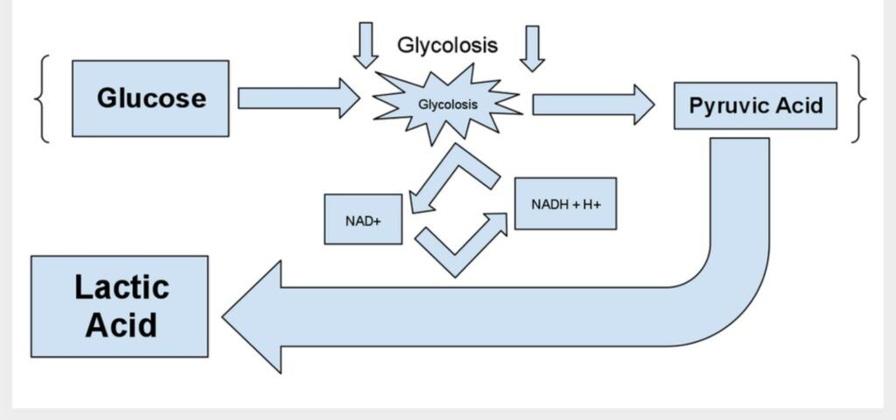

Slide 14
Anaerobic Respiration
The enzymes required for anaerobic respiration are available in the cytosol of the cell; therefore glycolysis and the conversion of pyruvate to lactic acid occurs in the cytosol.
Anaerobic respiration is very important during vigorous physical activity. Lactic acid can cause muscle pain and the body incurs an oxygen debt which has to be repaid after exercise.
Anaerobic respiration uses glucose to produce lactic acid and two ATP molecules in the absence of oxygen.

Slide 15
Aerobic Respiration
The complete breakdown of glucose to carbon dioxide and water requires oxygen. The pyruvate produced from glycolysis is completely broken down to carbon dioxide and water.
Occurs in the mitochondria of the cell.
To complete the breakdown of glucose, the two pyruvate molecules produced in glycolysis must enter a mitochondrion, where enzymes are available to allow the next series of reactions to occur.

Slide 16
Aerobic Respiration
Step 1-
For the pyruvate to enter the next pathway it is first converted to acetyl coenzyme A (acetyl CoA). To do this, a carbon dioxide molecule is removed from the pyruvate and the remaining two-carbon structure joins to coenzyme A. No ATP is produced in this process.
Step 2-
The acetyl CoA then enters the citric acid cycle, also known as the Krebs cycle. Here the carbon atoms in the acetyl CoA are released in carbon dioxide. For every acetyl CoA that enters the citric acid cycle, one molecule of ATP is also produced. This means that two ATP molecules are produced per glucose molecule.

Slide 17
Aerobic Respiration
Step 3-
The final stage of cellular respiration is the electron transport system; the only stage that uses oxygen. Here electrons are passed between molecules, finally resulting in oxygen molecules forming water. There is some debate regarding the exact number of ATP molecules that are produced during this process. Estimates range between 26 and 34 molecules.
Thus, aerobic respiration of one molecule of glucose has the potential to generate up to 38 molecules of ATP.
2 from glycolysis, 2 from the citric acid cycle and up to 34 from the electron transport mechanism.

Slide 18
Aerobic Respiration
C₆H₁₂0₆ + 6O₂ → 6CO₂ + 6H₂O
38 ADP + 38 P → 38 ATP

Slide 19
Aerobic Respiration summary
Aerobic respiration uses oxygen to convert glucose into carbon dioxide and water, producing up to 38 molecules of ATP per glucose molecule.
ATP is able to transfer energy from cellular respiration to other chemical reactions that require energy e.g. active transport

Slide 20
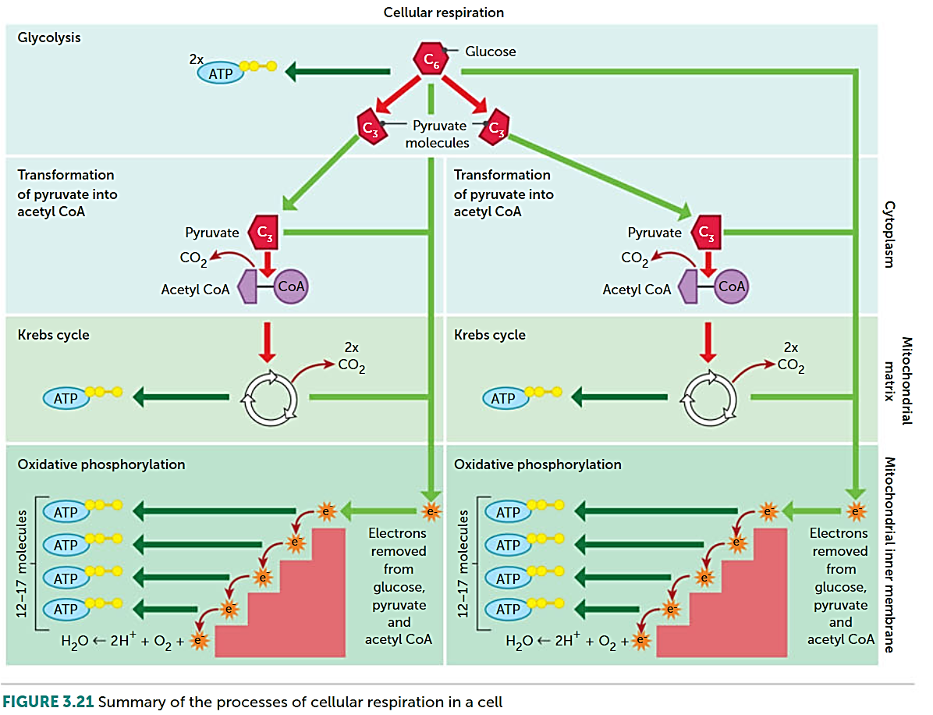

Slide 21
Energy used by the cell
Cells need the energy that is temporarily stored in the ATP molecules for a variety of purposes.
Building complex molecules
Cell division and growth
Movement of cell organelles
Movement of the whole cell
Maintaining cell organisation
Active transport
Transmission of nerve impulse

Slide 22
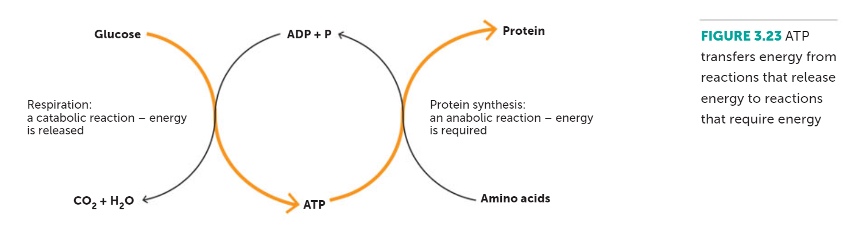

Slide 23
Recall Knowledge
Define ‘catabolic reaction’ and ‘anabolic reaction’.
Explain why energy is released when ATP forms ADP.

Slide 24
Apply Knowledge
Explain why cells that require a large amount of energy contain a lot of mitochondria.

Slide 25
Homework
Use a diagram to summarise the relationship between ATP and ADP

Slide 26
Reading
Pages 69 (bottom half)- 75: Cellular Respiration to
Energy used by the cell

